Slide 1
Semester: IV/VI/VIII Review: 4.1/ 6.1/ 8.1
Title of the Project:StudyHub
Domain: Software Group Members: Member1:Hitesh Ghuge
Member 2:Shreyash Garud
Member 3:Prasad Rane
Mentor Name:Mrs Rupali Lohar

Slide 2

Content
Introduction
Problem Statement
Objectives
Proposed Design (Flow Chart)
Implementation(Logic)
Results and Analysis
Conclusion
References

Slide 3
Introduction to Project
StudyHub is about transforming collaborative learning. We envision a world where knowledge sharing is seamless and impactful, unlocking the full learning potential of every student. Our goal is clear i.e to bridge the gap between learners and educators by providing a centralized, student-driven mobile platform. We firmly believe that education grows stronger when knowledge is shared, fostering curiosity, collaboration, and creativity.
What is StudyHub?
It's an innovative, student-driven mobile application designed for our community. Through StudyHub, students can explore and download a wide range of projects and study resources. They can also share their own high- quality academic work with peers, gaining recognition and points for their valuable contributions.

Slide 4

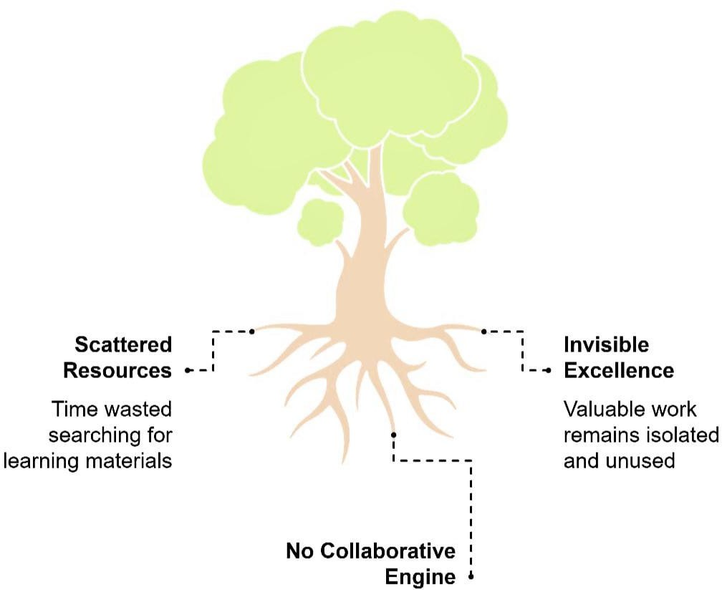
Problem Statement
Scattered Resources: Students waste precious time hunting for quality materials across countless drives, websites, and messaging apps.
Invisible Excellence: Brilliant projects and notes by students and faculty are created in isolation, their impact dying in a single classroom.
No Collaborative Engine: There is
no structured, rewarding system that encourages and recognizes knowledge sharing.

Slide 5
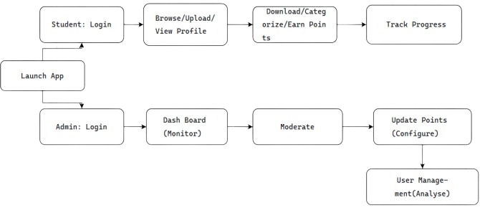
Proposed Design
User Management
Secure login with email/Google
Profile with academic info
Contribution tracking
Resource Hub
Categorized by course/subject
Advanced search & filters
PDF preview & one-tap download
Sharing Engine
Easy upload with auto-categorization
File validation (type, size)
Reward System
Points/Stars for uploads (+10) and downloads (+5)
Leaderboards & achievement badges
Progress tracking dashboard

Slide 6
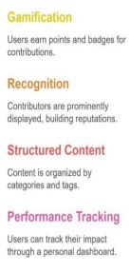
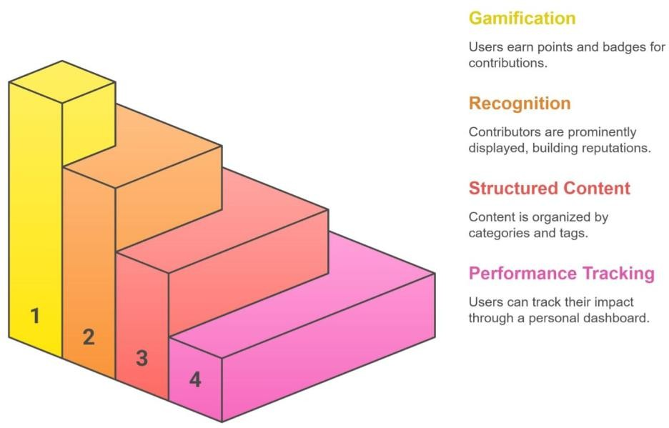
Objectives of the project
Centralized Repository: We are building a secure database to host and categorize diverse study resources, making them easily discoverable.
Facilitate Sharing: Through a simple mobile interface, we empower users to easily upload, search, and download content, breaking down barriers to knowledge exchange. This is about making sharing as easy as a few taps.
Performance Tracking: Students will have a personalized user dashboard for tracking their uploads, downloads, and accumulated points, gasifying the learning process and recognizing valuable contributions.

Slide 7
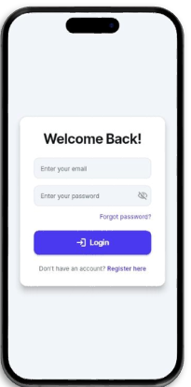
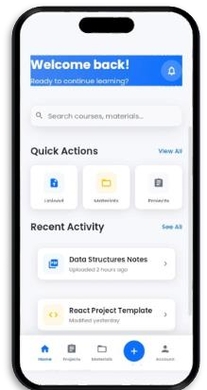
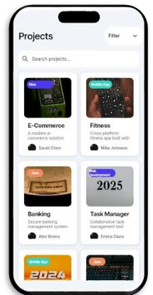
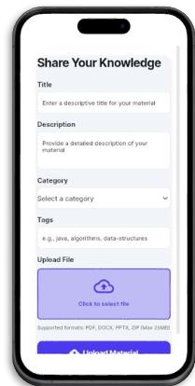
Implementation

Slide 8
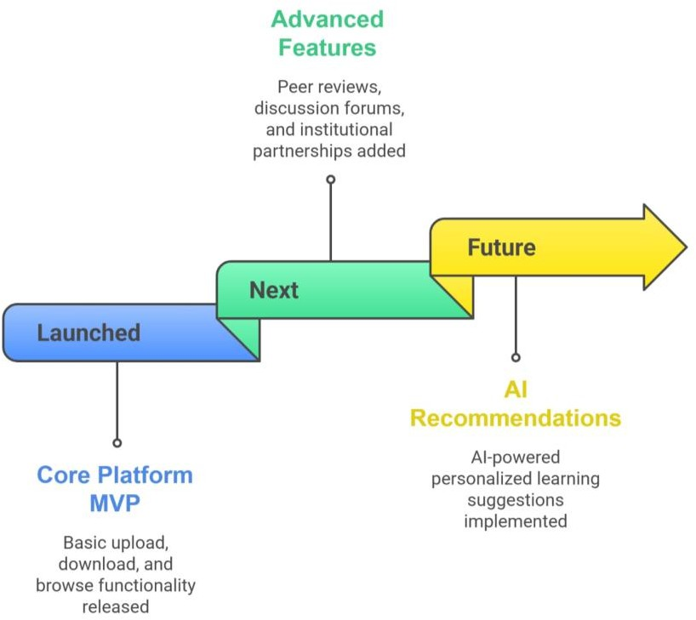
Result Analysis
Our initial analysis is extremely promising. We're seeing a significant increase in the accessibility of study materials, higher engagement from students willing to share their work, and positive feedback on the user- friendly interface. StudyHub is already proving its ability to foster a more connected and collaborative academic environment.

Slide 9
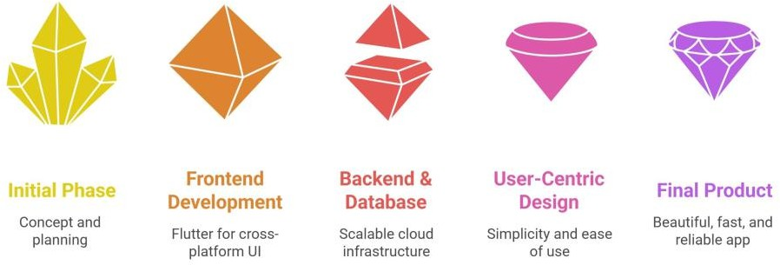
Conclusion
Solves a Real, Painful Problem: We are fixing a universal academic inefficiency.
Built for and by Students: Our user-centric design ensures high adoption and engagement.
Scalable & Sustainable Model: The platform creates inherent value as more users join.
StudyHub is more than just an application it's a movement towards a more collaborative and empowered learning future. We are building a platform that not only solves the immediate problem of scattered resources but also cultivates a culture of sharing, recognition, and continuous growth within our academic community

Slide 10
References
Google Developers (2024) Firebase Documentation – Cloud Firestore, Authentication, and Storage.
Flutter Documentation. (2024). Flutter – Build beautiful native apps in record time. https://flutter.dev/docs.
GitHub Open Source Repositories. (2024). Student Resource Sharing Platforms and Study Material Apps. https://github.com/topics/education-app

